Slide 1
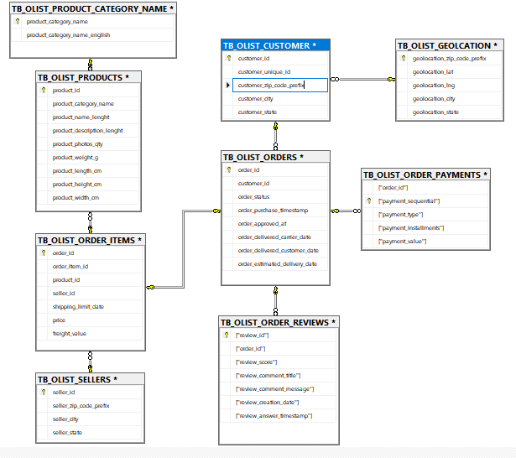
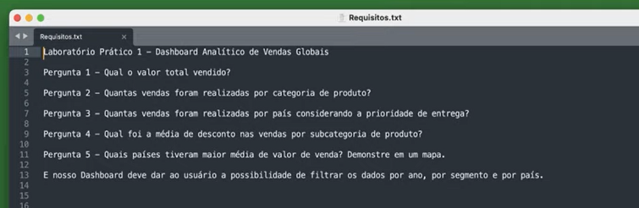

Slide 2
- Dataset OLIST- Overview das 9 tabelas
SELECT TOP 5* FROM dbo.TB_OLIST_CUSTOMER
SELECT TOP 5* FROM dbo.TB_OLIST_GEOLCATION
SELECT TOP 5* FROM dbo.TB_OLIST_ORDER_ITEMS
SELECT TOP 5* FROM dbo.TB_OLIST_ORDER_PAYMENTS
SELECT TOP 5* FROM dbo.TB_OLIST_ORDER_REVIEWS
SELECT TOP 5* FROM dbo.TB_OLIST_ORDERS
SELECT TOP 5* FROM dbo.TB_OLIST_PRODUCT_CATEGORY_NAME
SELECT TOP 5* FROM dbo.TB_OLIST_PRODUCTS
SELECT TOP 5* FROM dbo.TB_OLIST_SELLERS

Slide 3
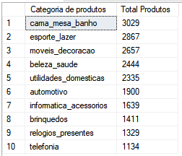
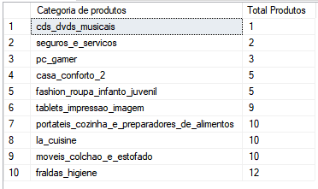
-- Categorias com maior número de produtos cadastrados--
SELECT top 10
[product_category_name] AS " Categoria de produtos ", COUNT(*) AS "Total Produtos" FROM [dbo].[TB_OLIST_PRODUCTS]
GROUP BY product_category_name
ORDER BY COUNT(*) DESC
-- Categorias com menor número de produtos cadastrados--
SELECT top 10
[product_category_name] AS " Categoria de produtos ", COUNT(*) AS "Total Produtos" FROM [dbo].[TB_OLIST_PRODUCTS]
GROUP BY product_category_name
ORDER BY COUNT(*) ASC

Slide 4
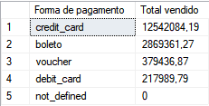
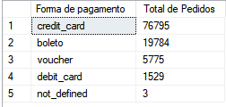
--Total Pago por forma de pagamento--
SELECT DISTINCT["payment_type"] AS "Forma de pagamento" , ROUND(SUM(["payment_value"]),2) AS "Total vendido"
FROM TB_OLIST_ORDER_PAYMENTS
GROUP BY ["payment_type"]
ORDER BY 2 DESC
SELECT DISTINCT["payment_type"] AS "Forma de pagamento", count(["payment_installments"]) AS " Total de Pedidos"
FROM
TB_OLIST_ORDER_PAYMENTS
GROUP BY ["payment_type"]
ORDER BY " Total de Pedidos" DESC

Slide 5
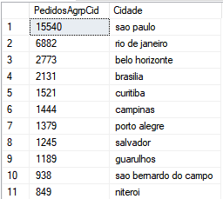
--Clientes agrupados por origem--
SELECT COUNT([customer_id]) AS PedidosAgrpCid, customer_city AS Cidade FROM [TB_OLIST_CUSTOMER]
GROUP BY customer_city
ORDER BY PedidosAgrpCid DESC;

Slide 6
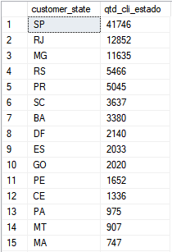
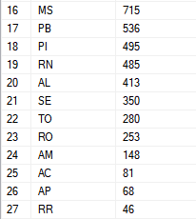
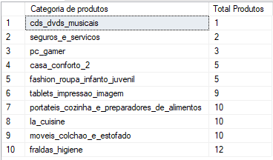
-- Quantidade de clientes por estado--
SELECT customer_state,COUNT(customer_id) AS qtd_cli_estado
FROM dbo.TB_OLIST_CUSTOMER
GROUP BY customer_state
ORDER BY qtd_cli_estado DESC
-- Categorias que menos vendem --
SELECT top 10
[product_category_name] AS " Categoria de produtos ", COUNT(*) AS "Total Produtos" FROM [dbo].[TB_OLIST_PRODUCTS]
GROUP BY product_category_name
ORDER BY COUNT(*) ASC

Slide 7

--Estudo sobre quantidade de fotos por anúncio de 0-5 fotos--
SELECT COUNT(product_photos_qty) AS "Sem fotos",(SELECT COUNT(product_photos_qty) FROM dbo.TB_OLIST_PRODUCTS
WHERE product_photos_qty = 1) AS "1 Foto",(SELECT COUNT(product_photos_qty) FROM dbo.TB_OLIST_PRODUCTS
WHERE product_photos_qty = 2) AS "2 Fotos",(SELECT COUNT(product_photos_qty) FROM dbo.TB_OLIST_PRODUCTS
WHERE product_photos_qty = 3) AS "3 Fotos",(SELECT COUNT(product_photos_qty) FROM dbo.TB_OLIST_PRODUCTS
WHERE product_photos_qty = 4) AS "4 Fotos",(SELECT COUNT(product_photos_qty) FROM dbo.TB_OLIST_PRODUCTS
WHERE product_photos_qty >= 5) AS "5 Fotos ou mais" FROM dbo.TB_OLIST_PRODUCTS
WHERE product_photos_qty = 0

Slide 8
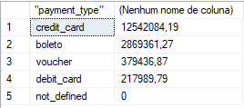
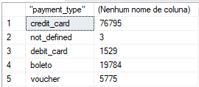
-- Valor total de vendas por categoria de pagamento--
SELECT DISTINCT["payment_type"], ROUND(SUM(["payment_value"]),2)
FROM TB_OLIST_ORDER_PAYMENTS
GROUP BY ["payment_type"]
ORDER BY 2 DESC
-- Quantidade de pagamentos por forma--
select DISTINCT["payment_type"], COUNT(["order_id"])
FROM TB_OLIST_ORDER_PAYMENTS
GROUP BY ["payment_type"]

Slide 9
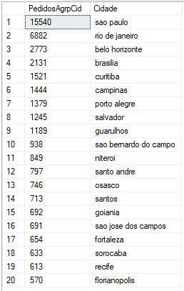
--Top 20 cidades com mais pedidos --
SELECT TOP (20) COUNT(2) AS PedidosAgrpCid, customer_city AS Cidade FROM [TB_OLIST_CUSTOMER]
GROUP BY customer_city
ORDER BY PedidosAgrpCid DESC;

Slide 10
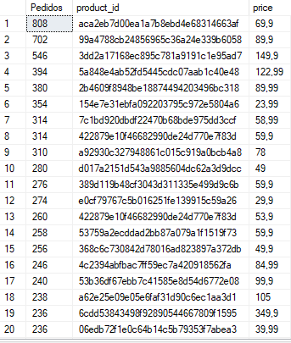
--Quantidade de pedidos por produto--
SELECT COUNT(o.order_id) AS Pedidos, i.product_id, i.[price] FROM dbo.TB_OLIST_ORDERS o
JOIN dbo.TB_OLIST_ORDER_ITEMS i ON o.order_id = i.order_id
GROUP BY i.product_id, i.price
ORDER BY 1 DESC
select count (seller_id) as "Total Vendedores", seller_state
from [dbo].[TB_OLIST_SELLERS]
group by seller_state
order by [Total Vendedores]

